Slide 1
jActivity:
Bringing Machine Learning and Context-Awareness
into the (Mobile) Browser
Anja Bachmann bachmann@teco.edu (KIT)

Slide 2
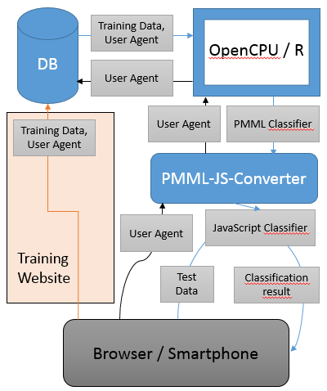

jActivity: Classification within the Browser
Data collection
Website to collect training data to build classifiers
MySQL database
Database to store training data and metainformation
Machine Learning in R via OpenCPU
Create Predictive Model Markup Language (PMML) models (classifiers)
PMML to JS converter
Convert PMML to JS to make the classifiers runnable in browser
Classification within the browser
Include JS files and implement callback functions to provide context-awareness to website / web apps
Restful API
To connect components via HTTP/JSON
Special property: personalized (user-agent dependent) or generalized classifiers
Anja Bachmann bachmann@teco.edu (KIT)

Slide 3
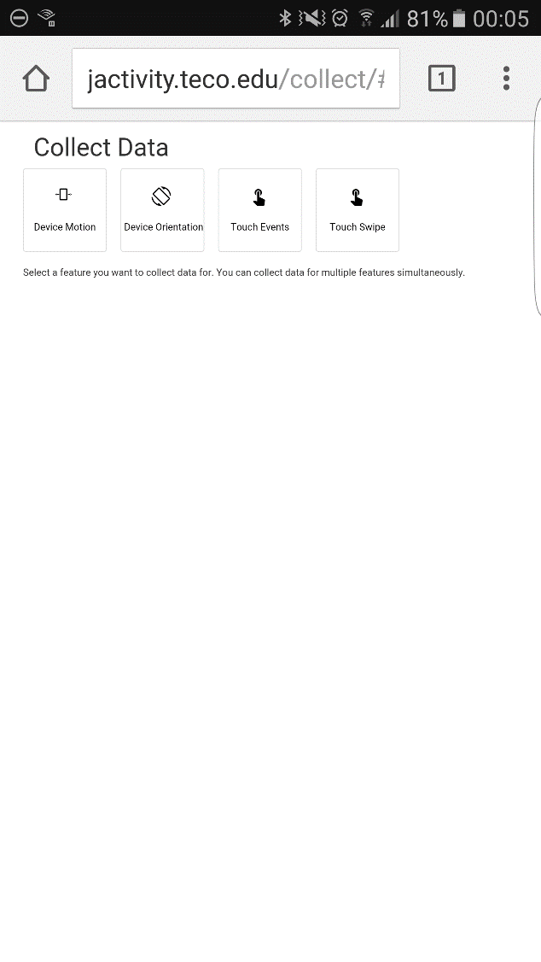
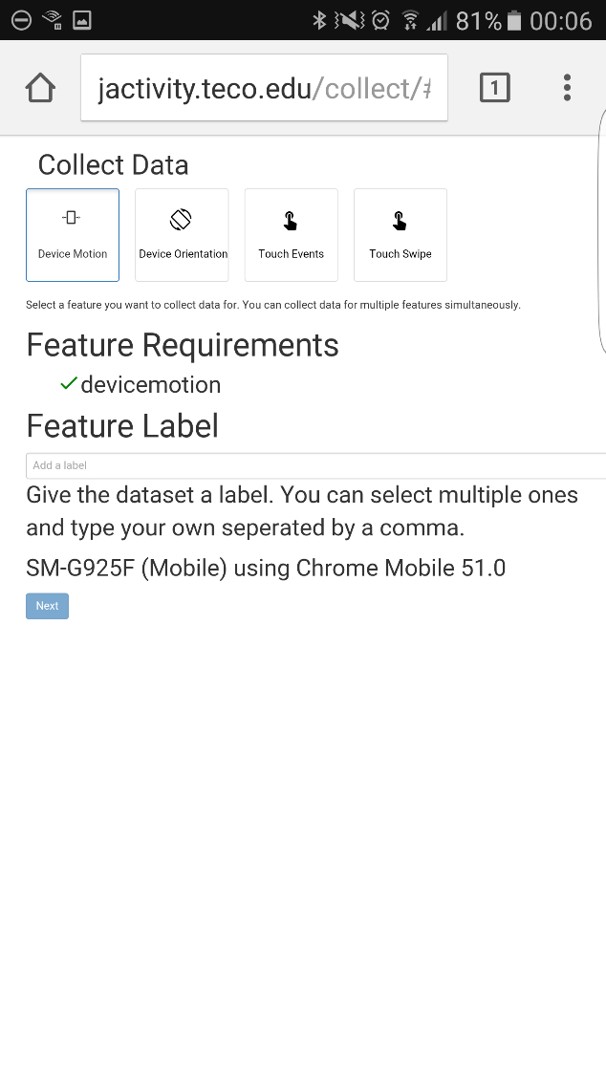
Data Collection
Website to collect training data
Selection of event / sensor, class label and identification of user agent / device + browser
Anja Bachmann bachmann@teco.edu (KIT)

Slide 4
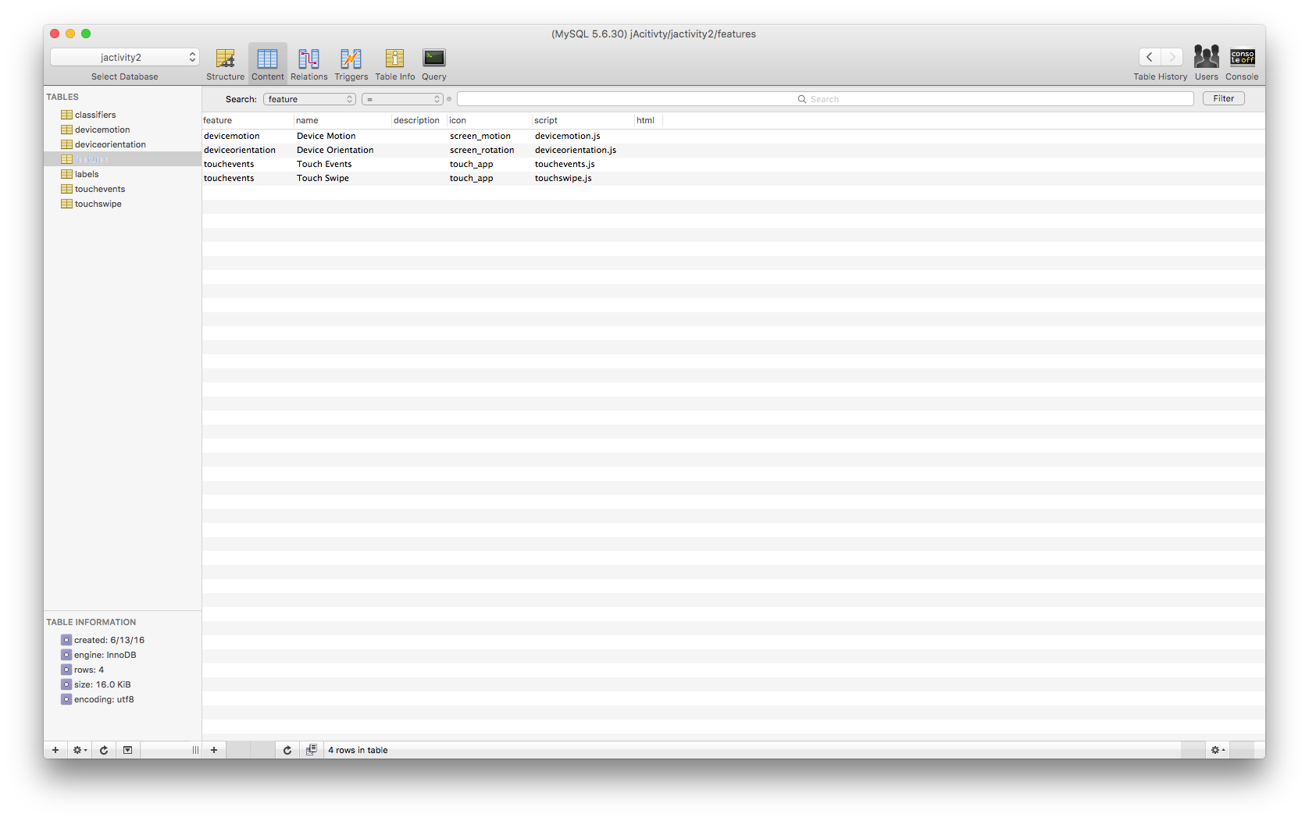
MySQL Database
Contains one table per sensor feature
Anja Bachmann bachmann@teco.edu (KIT)

Slide 5
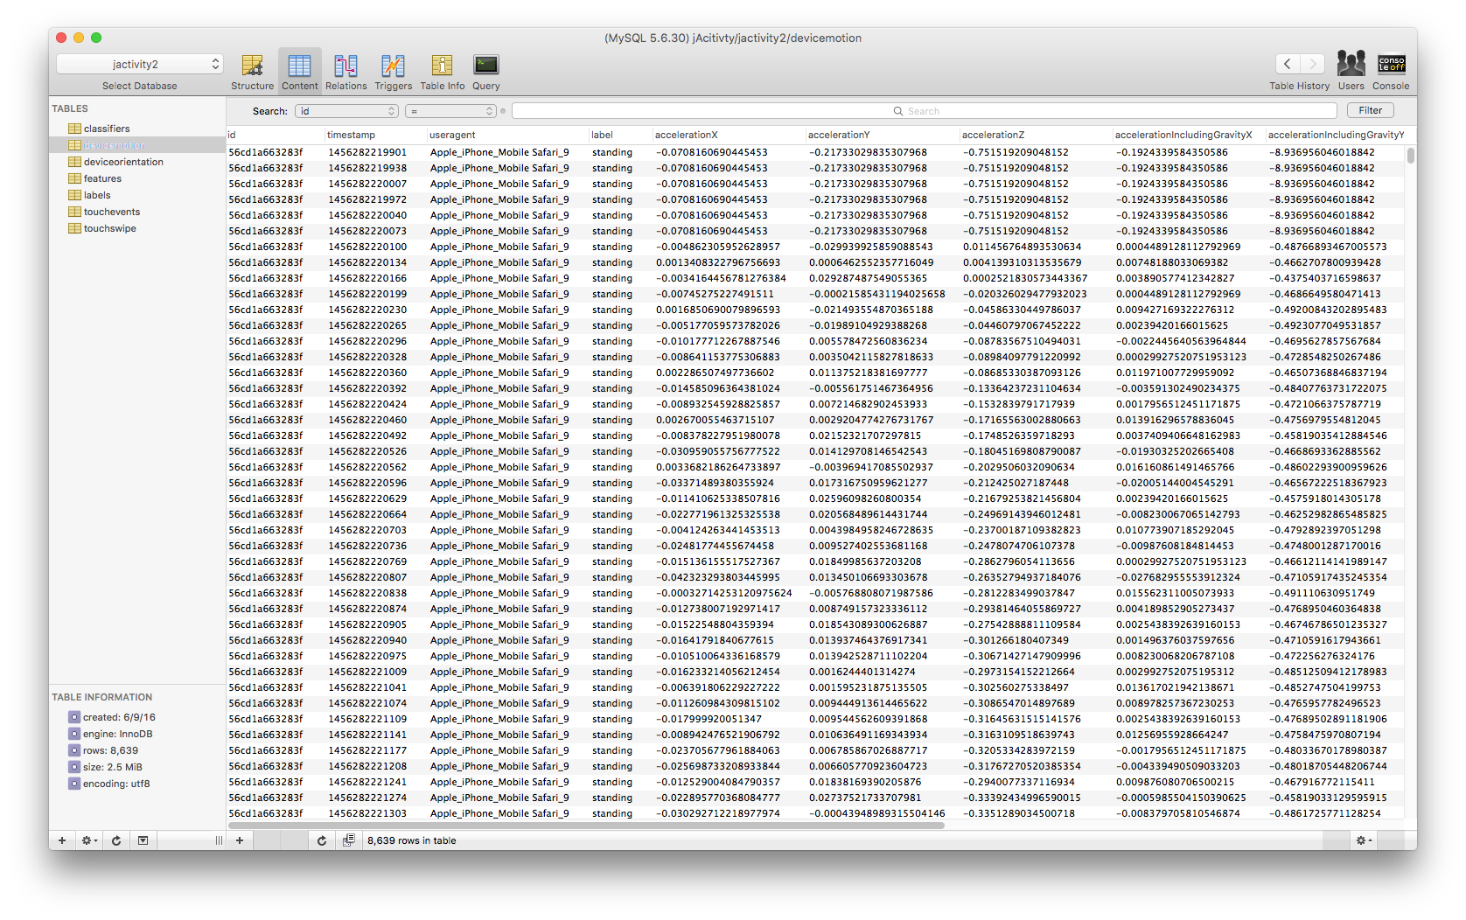
MySQL Database
Contains training data with all attributes per sensor feature
Anja Bachmann bachmann@teco.edu (KIT)

Slide 6
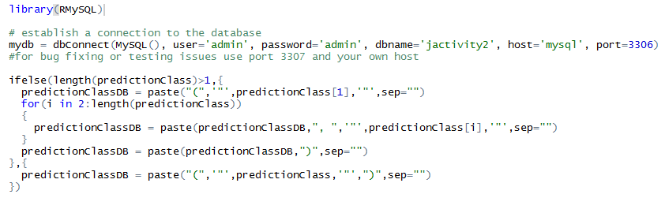
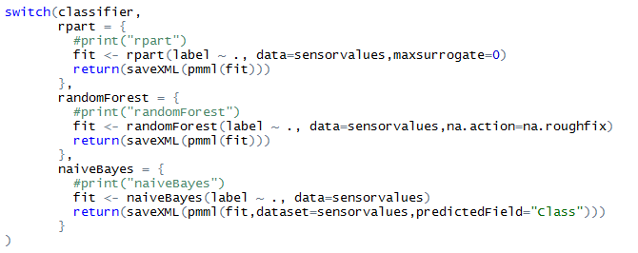
Machine Learning in R via OpenCPU
Create Predictive Model Markup Language (PMML) models (classifiers)
E.g. get data from database, preprocess it (not shown) and classify (based on selected method)
Anja Bachmann bachmann@teco.edu (KIT)

Slide 7
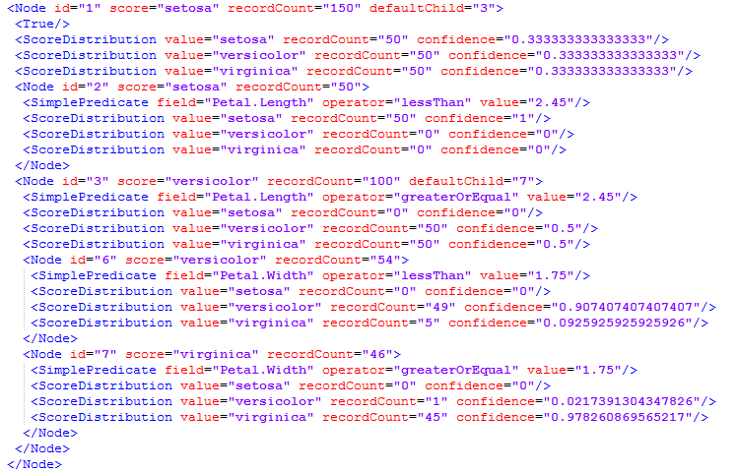
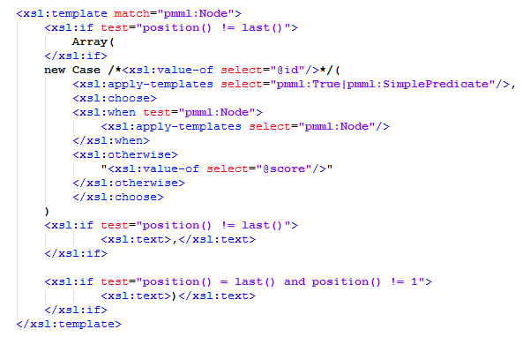
PMML to JS Converter
To run classifiers in the browser in real-time we need to convert PMML to JavaScript
Non-trivial process:
Convert PMML (XML-format) using XSL (Extensible Stylesheet Language)
Specifies how the XML should be transformed
Yields JavaScript classifiers that evaluate sensor data and return predicted class
Anja Bachmann bachmann@teco.edu (KIT)

Slide 8
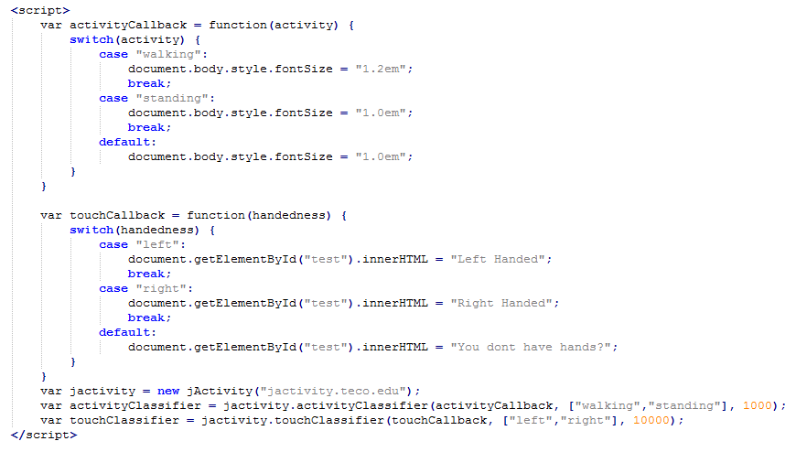
Classification within the Browser
Include JS files and implement callback functions to provide context-awareness to websites
Anja Bachmann bachmann@teco.edu (KIT)

Slide 9
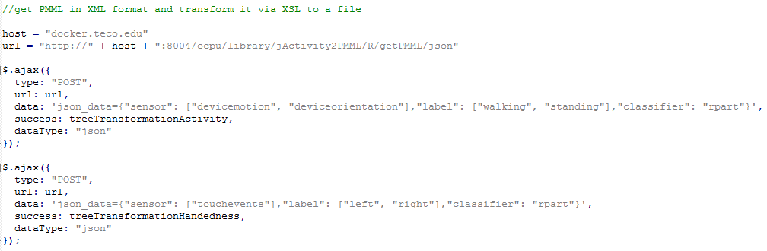
REST APIs for Communication
To allow communication between components, we use REST APIs
E.g. to request a classifier
Where URL is the host of jActivity
Anja Bachmann bachmann@teco.edu (KIT)

Slide 10
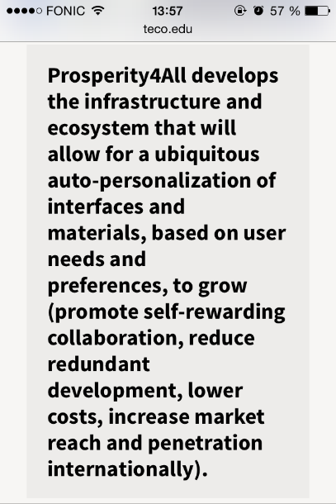
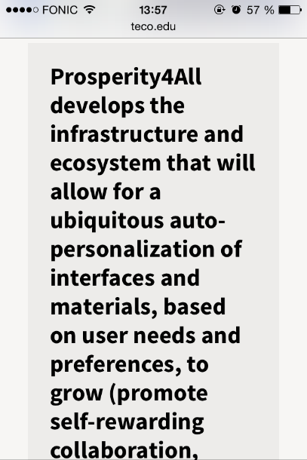
Adaption to User Activity and Behavior
Use cases:
In general: automatic detection of preferences or needs
Adapt font size of web sites to current activity: increase font size while walking
Adapt navigation menu to dominant hand: position the menu button and the slide-in menu on the left site for left handed users
Current Demo
Analyze device motion and orientation data
Recognize physical activity using decision tree algorithm
Adapt font size to recognized activity
Open issues:
Crowdsource more and diverse training data
Evaluate more features
Implement further classifiers (e.g. random forest)
Anja Bachmann bachmann@teco.edu (KIT)

Slide 11
It‘s Your Turn!
What are you interested in?
Let us all discuss about interesting class labels and sensors
Collect your own training data:
Visit http://jactivity.teco.edu/collect/ to collect training data
Afterwards, we will have a look at the new data within our database
And create an example website with a suitable classifier
See if the example works:
Test the example website within the browser
http://jactivity.teco.edu/example/
Anja Bachmann bachmann@teco.edu (KIT)

